Slide 1

Repo Convergence
Shachar Or SW Engineer TL

Slide 2




This Is A story about a journey
1
2
3
4
One REPO to rule them all
Notes:
זה סיפור על מסע
בספר שר הטבעות פרודו ההוביט עשה את המסע מהפלך עד למורדור, בשביל להשמיד את הטבעת האחת
אנחנו הולכים לעשות את המסע ההפוך
מתחילים במורדור, מקום אפל, כאוטי, שבו למפתחים קשה לעבוד בצורה יעילה.
בכמה צעדים אנחנו נגיע לפלך.
כל זה כדי להגיע לרפו היחיד

Slide 3
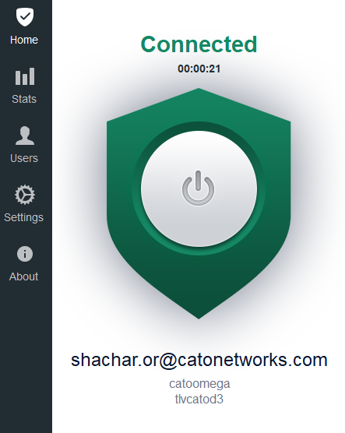
The Product
ZTNA agent (prev. VPN)
Development started at 2015
Desktop application
>300,000 different users
(~150,000 active daily)

Slide 4



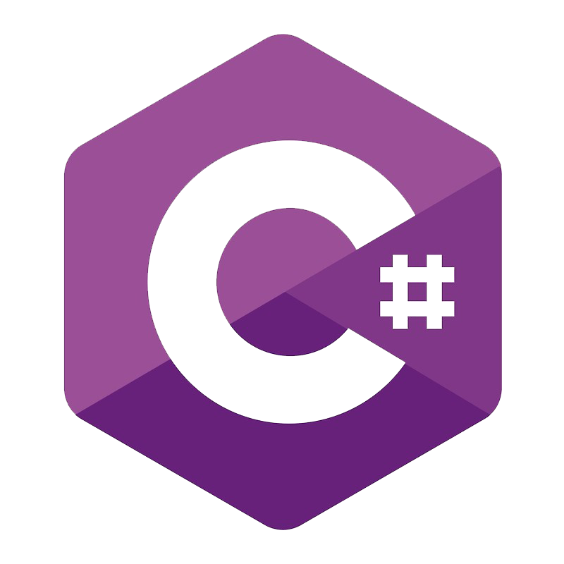



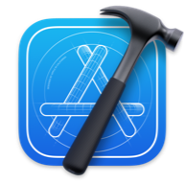

Starting Point
Common Library
C
Windows client
C++, C#, Visual Studio
Git submodule 🤓
Symlink 😬
Please put repos in the same dir 😅
Linux client
C, gcc, Makefiles, VIM
IOS client, Mac client,
Swift, Xcode

Slide 5
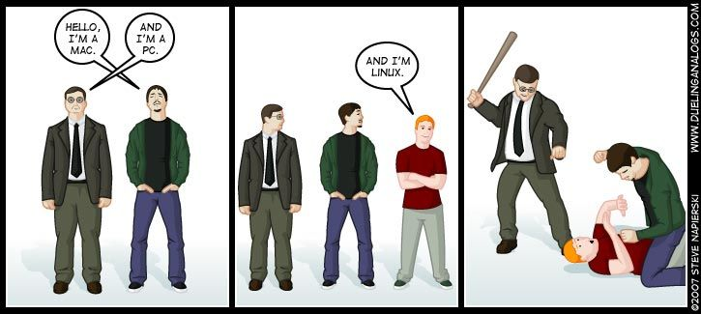
Starting Point – So What’s Wrong?
Wastes time (branches, git-submodule)
CI is hard
Same product – 3 completely different ways to build
The team is more segregated

Slide 6
The Journey Begins…
Notes:
שוק ה־SASE מקיף כ־10 מיליארד דולר

Slide 7





Step 1: Single Repo
Good old copy & paste
Git submodule
Git subtree

Slide 8


Step 1: Single Repo
Copy
–
paste
Submodule
Subtree
Day
-
to
-
day use?
EASY
HARD
EASY
Keeps history?
NO
YES
YES
Merging from old repo?
HARD
EASY
FAIR
# Just once time to setup subtree
> git remote add windows-repo git@bitbucket.org:repos/windows.git
> git fetch window-repo
> git subtree add --prefix windows window-repo master
# Merge from old repo
> git pull –s subtree windows windows-repo master
# Each time we want to get updates
> git pull
Updating 2f2a860b..fe842594
> git submodule update
Submodule path ‘common-lib': checked out 'd4876d459de67ca964bd92’
# Each time we want to open a new branch
> git checkout –b new_branch
Switched to a new branch 'new_branch’
> cd common-lib
> git checkout –b new_branch
Switched to a new branch 'new_branch'

Slide 9
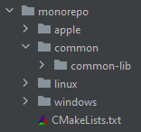
Step 1: Single Repo - Results

Slide 10
Step 2: Build System
Challenges:
1) Single place to define compilation
2) Flexibility per team member preferences (VS, Xcode)
3) Support additional scripting (e.g. protobuf generation)
Bonus! Supports C# & Swift
C++ 2019 echo-system by JetBrains: https://www.jetbrains.com/lp/devecosystem-2019/cpp/

Slide 11
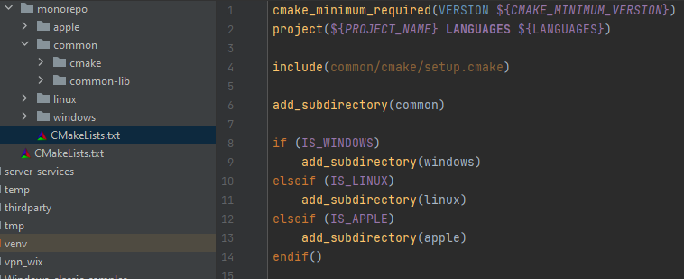



Slide 12
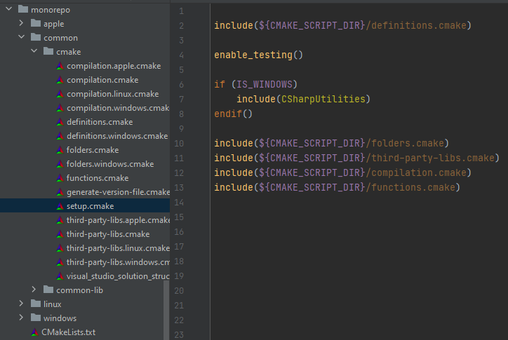

Slide 13
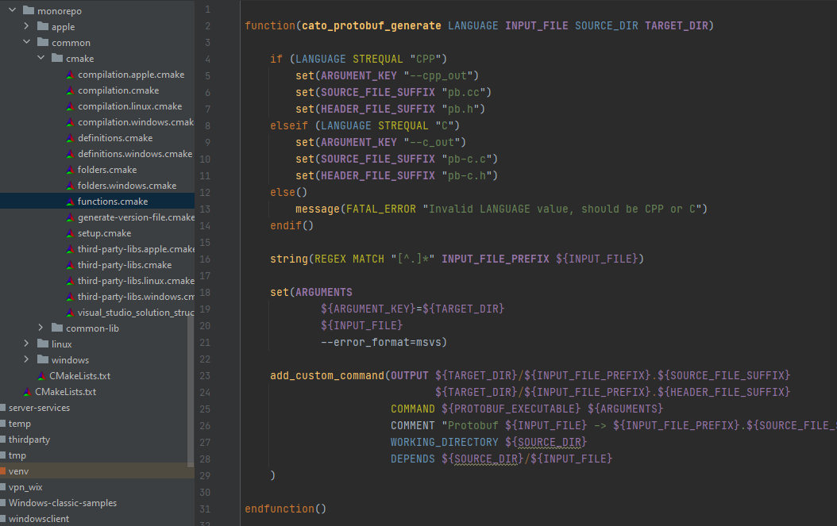
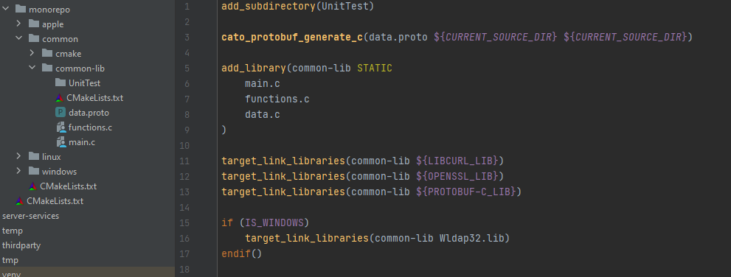

Slide 14
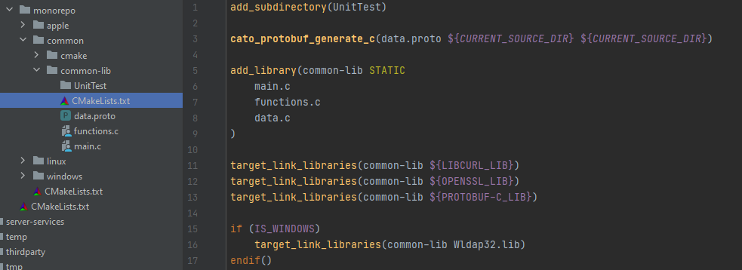

Slide 15


Step 3: 3rd Party Libraries
Starting point: Each OS had different scripts to compile 3rd party libraries
2 Options:
VCPKG
Simplest
Conan
More control
Support multiple versions of the same package
C++ 2020 echo-system by JetBrains: https://blog.jetbrains.com/clion/2020/06/dev-eco-cpp-2020/

Slide 16
Step 3: 3rd party libraries – Conan 101
Server
Each package/version has a recipe file
A recipe file support multiple OS and build settings
Recipe + build parameters = binary package
Pkg/0.1
BINARY
Win/VS14
RECIPE
BINARY
Linux/gcc
Fetch recipe
Fetch package binary
Client
$ conan install Pkg/0.1 –s os=Linux – s compiler=gcc
BINARY
RECIPE
BINARY
Build locally

Slide 17
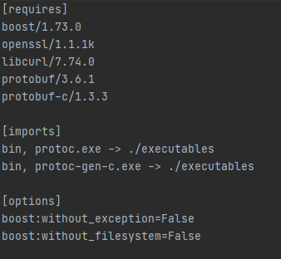
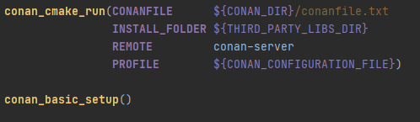
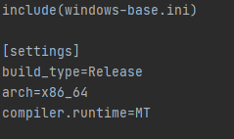
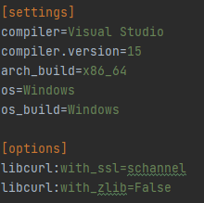
Step 3: 3rd Party Libraries - Conan
conanfile.txt
windows-x64-release.ini
Result
windows-base.ini
# CONAN_INCLUDE_DIRS_LIBCURL=C:/…/.conan/data/libcurl/7.74.0/_/_/package/…/include
# CONAN_LIBS_LIBCURL=libcurl;ws2_32
# CONAN_DEFINES_LIBCURL=-DCURL_STATICLIB=1

Slide 18

Step 4: Wrapping Up
Building for different OS is still complex…
Different CMake commands
Different steps
Different CI configuration per OS
Not everything command-line
cmake -S . -B build_dir\win64-release -G "Visual Studio 17 2022" -A x64 -D BUILD_MODE:STRING=Release

Slide 19
Solution: A Python Script to Unite Them All
> build_all.py --version 1.0.0 -c win64-debug win64-release
- configurations: ['win64-debug', 'win64-release']
- steps: ['clean', 'cmake', 'nuget', 'build', 'package', 'test']
- project_version: 1.0.0
- Current working dir: C:\workspace\end-point-protection-poc\ep
- Current logging dir: build_dir\build_all_script\logs\2022-05-28_20-19-21
- is_verbose: False
win64-debug/clean-> cmd: if exist build_dir\win64-debug rmdir /s /q build_dir\win64-debug
win64-debug/clean-> SUCCESS!
win64-debug/cmake-> cmd: cmake -S . -B build_dir\win64-debug -G "Visual Studio 17 2022" -A x64 -D BUILD_MODE:STRING=Debug
win64-debug/cmake-> SUCCESS!
win64-debug/nuget-> cmd: build_dir\build_all_script\nuget.exe restore build_dir\win64-debug
win64-debug/nuget-> SUCCESS!
win64-debug/build-> cmd: cmake --build build_dir\win64-debug --config Debug --target ALL_BUILD
win64-debug/build-> SUCCESS!
win64-debug/package-> cmd: cmake --build build_dir\win64-debug --config Debug --target PACKAGE
win64-debug/package-> SUCCESS!
win64-debug/test-> cmd: cmake --build build_dir\win64-debug --config Debug --target RUN_TESTS
win64-debug/test-> SUCCESS!
win64-release/clean-> cmd: if exist build_dir\win64-release rmdir /s /q build_dir\win64-release
win64-release/clean-> SUCCESS!
win64-release/cmake-> cmd: cmake -S . -B build_dir\win64-release -G "Visual Studio 17 2022" -A x64 -D BUILD_MODE:STRING=Release
win64-release/cmake-> SUCCESS!
win64-release/nuget-> cmd: build_dir\build_all_script\nuget.exe restore build_dir\win64-release
win64-release/nuget-> SUCCESS!
win64-release/build-> cmd: cmake --build build_dir\win64-release --config RelWithDebInfo --target ALL_BUILD
win64-release/build-> SUCCESS!
win64-release/package-> cmd: cmake --build build_dir\win64-release --config RelWithDebInfo --target PACKAGE
win64-release/package-> SUCCESS!
win64-release/test-> cmd: cmake --build build_dir\win64-release --config RelWithDebInfo --target RUN_TESTS
win64-release/test-> SUCCESS!

Slide 20
Conclusion
git subtree
CMake
Conan
Touch-up Scripting

Slide 21


Questions?
github.com/shachar-xor/repo-convergence
shachar.xor@gmail.com

Slide 22
THANK YOU
Shachar Or SW Engineer TL

